Slide 1
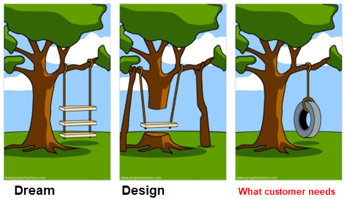
DynAMo Standard Sync,
Quality, Testing, Troubleshooting and…
Alternative Active Sync
By
Barbara Schubert

Slide 2
Topics
Introduction
    General Issues with Standard sync and collection (known limitations…)
How to Implement Standard sync
  Configuration challenges + unreliability (can stop working)
How to Test sync quality
    Other quality issues and how to troubleshoot and escalate…
Alternative Active Sync Instructions for ESVT
    (will not cover Hybrid and TPS in this presentation)
    Will show\email practical Install Guide
Magic query

Slide 3


Quiz
I have followed DynAMo Guides, scheduled TagListGen, and ActiveSync, files are created, upgraded with no issue, all channels are green, all is good?
Maybe yes, maybe no. Definitely this is not the verification of properly configured sync!

Slide 4
Quiz
Should we properly test Active Alarm, Suppressed, and Shelved reports and escalate if any issues?
Who is “we”? What “properly” means?
(Barbara opinion) during project implementation we do NOT have time…
Just at least make sure Sync is implemented “properly”…
I will tell you about several quality issues I am aware of (to set expectations) …

Slide 5

Our goals (per Barbara)
Immediate goal….
Close to Perfect Sync (add sync for shelving…), No need for manual interventions (e.g. close open alarms, unsuppress, or unshelve from Web)
Eliminate “confusion periods”
Reduce “-useless” events
Reduce OPC dependency
Short/Long term goal…
Remove OPC dependency
DynAMo-Generated events in M&R
only when needed
Very Long term goal…
Eliminate sync for Honeywell systems (needs Experion+TPS fixes… TPS fixes not likely)
Do not focus exclusively on long term goals, first fix what is achievable short term=sync!

Slide 6
True or …NOT?
Active Sync for pure Experion is perfect
Suppression sync is perfect
ESVT Active Sync has only very few (documented) limitations
Just sync EST with ESVT and standard sync is perfect
Exxon does not complain about (ESVT\TPS) Active Sync (so this is a proof they are perfect)
Development is fully aware of the quality issues we have
If Customers do not complain we do not have issues
(are they happy or discouraged\frustrated? )
We know how to implement and test Standard sync
We know how to troubleshoot Standard Sync
We cannot change the way we sync, new (Barbara’s) way is too complicated, we need developers to implement it
Notes:
Are customers happy or discouraged

Slide 7

Summary of quality issues?
Active Alarms report incorrect
Shelved report incorrect
Suppressed report incorrect
Overload of OPC
OPC failures or confusions (e.g. Advanced Security etc)
Confusing events generated in DynAMo
Wrong events generated in DynAMo
Confusing metrics… I think not what customer wants
  DAS suppression
  Priority suppression
  ….
Confusing columns with no meaningful info (Columns: shelved, suppressed, visible)
etc etc etc
We come to upgrade…
Do not assume Sync is working

Slide 8
Barbara’s terminology
“Alternative” ESVT\EST Active Sync
“Confusion Period”
“Waking up points”
“DynAMo generated events” (unfortunately) include
“…-useless”
“…-confusing”
“…-wrong”
=“…-excessive” (~95%)
Can we prevent them? Answer: only some right now, in future hope many many more… so finally DynAMo will auto-generate events only when needed

Slide 9

ESVT “Unknown Timestamp” and quality
Only HF6 has the fix.
This is critical fix we need to deploy to all with ESVT system…. Later we all will need to remove this fix (but not critical if you forget).
V9 of the rules go back to initial implementation (means without HF6… it is bad performance as cache will be built since 1979)
Additional (unrelated) benefit of the trigger:
It may be used to prevent the creation of new paths…

Slide 10
Active Alarms Quality (per Barbara)…
Assuming Active Sync is configured right…
(and unknown timestamp hotfix is implemented)…
“accurate” means DAS + shelved is accurate also
PROCESS ALARMS ():
Hybrid system: 60% quality degrades over time
    better disable Active Sync
TPS system: 50% quality degrades over time
TPS (EJC): 93% quality degrades over time
ESVT: 90%.... if (1) unknown timestamp fix implemented and (2) consoles synced
    In some cases… maybe better disable Active Sync without unknown timestamp hotfix
ESV: 95% (SYSTEM ALARMS: 70%)

Slide 11
Suppressed Sync Quality (per Barbara)
Assuming Suppressed Sync is configured right…
DISABLE-ENABLE-INHIBIT:
70-99%, degrades over time
Causes DRASTIC load to the system.
OPC other issues
DAS (partial sync with Active Sync)
90% process active alarms but…System tags are mostly wrong, alarms not in-alarm are often wrong
Overall - 50% as... Our reporting is NOT what customer wants
Priority (no sync)
This should by default disabled in our standard rules!

Slide 12
Shelved Quality (per Barbara)
70% accurate but the cost of that is high:
Large number of “…-confusing” events
(+”…-useless” events)
For active process alarms quality >90%
For active system alarms quality 60%

Slide 13
DynAMo Standard Sync
- how to implement
By
Barbara Schubert

Slide 14
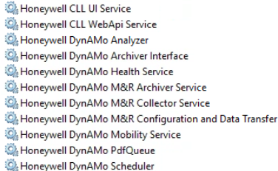
M&R – Simplified Data Flow
Archiver
(service)
Collector
(service)
Message Parsing
(Rules)
Messages
Post Processing
(VB Script)
Viewer
Email
Scheduler
(service)
Database(s)
Web Reports
Analyzer
(service)
Queue
Archiver Interface (service)
Assets, Events
Cache

Slide 15
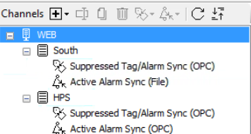
Active Alarm Sync – OPTIONS
For TPS\ESVT use Active Alarm Sync (File)
For Experion use Active Alarm Sync (OPC)

Slide 16
Syncing data flow
Active Alarms Sync
Suppression Sync
ESVT\TPS
Experion
TAGLIST GEN UTILITY
Configure Tag List Gen Utility and schedule in Windows Tasks to Get the list of ‘Suppression’ Parameters
ACTIVESYNC UTILITY Configure Active Sync Utility and schedule in Windows Tasks
to Get list of Alarms (from ESVT or M&R) and verify alarms
COLLECTOR List of ‘Suppression’ Parameters will be read through OPC to get values that define disable\enable status
COLLECTOR will get a file
COLLECTOR will Get list of Alarms
HM collector is to collect and NOT to sync TPS
Active Sync (File)
Active Sync (OPC)
Suppressed Sync (OPC)
Active Sync Utility will use Map files

Slide 17
Quiz
Which channel syncs Suppressed Report?
Active Sync channel
Suppressed Sync channel
Suppressed channel only syncs Disable\Enable\Inhibit
Active syncs DAS (partially)
There is no sync for “Priority” or “Asset” shown in Suppressed report

Slide 18
Terminology
Some terms have different definitions in different DCS systems. What is M&R terminology?
  Suppressed
  Disabled
  Inhibited
  Shelved
  Journaled
  Defeated
  Suppressed – Category=“Priority”, Category=“DAS”
  DAS
  Cutout
  Inactive
  OOS

Slide 19
Disable Sync channels
STEP: Disable all Sync subchannels (Archiver+Collector)…
you need step-wise testing first

Slide 20
Suppression sync:
Get ready for collector

Slide 21

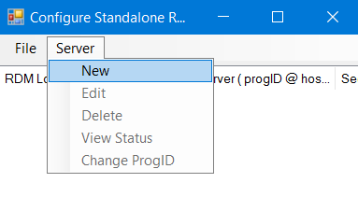
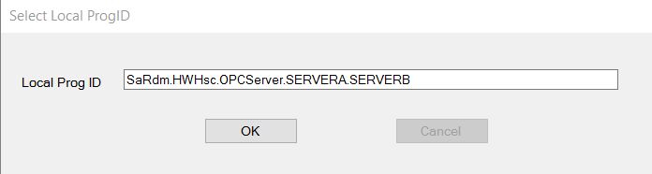
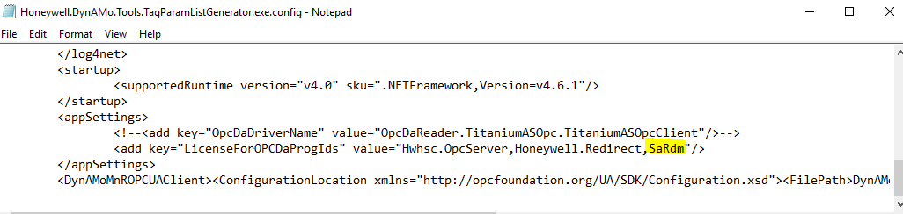
Configure RDM standalone – NO CUSTOM!!
Run Standalone RDM Configuration from C:\ProgramData\Microsoft\Windows\All Honeywell tools\Redirection Manager
Select Server\New
In the past…. If ProgID does not contain string “HWHsc.OPCServer” edit
but this does not work any more in 210
C:\Program Files (x86)\Honeywell\DynAMo\Utilities\Tag List Generator\Honeywell.DynAMo.Tools.TagParamListGenerator.exe.config
In pre-210 ….
If HWHsc.OPCServer not in substring of ProgID… add custom substring e.g. SaRdm if this is ProgID SaRdm.North
Notes:
In 202.1 is works… then it will break in 210.

Slide 22
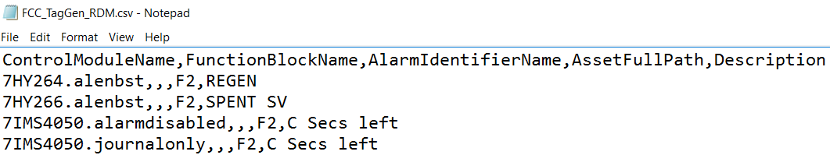
Project Checklist – Suppressed Sync
Step: (TagListGen tag.parameter present): Check CSV files have parameters
This is wrong…
    7HY264.,
This is right
    7HY264.alenbst,
  ISSUE: in DynAMo 210 we have defect…RDM can only have standard name, else DynAMo will not add parameters

Slide 23
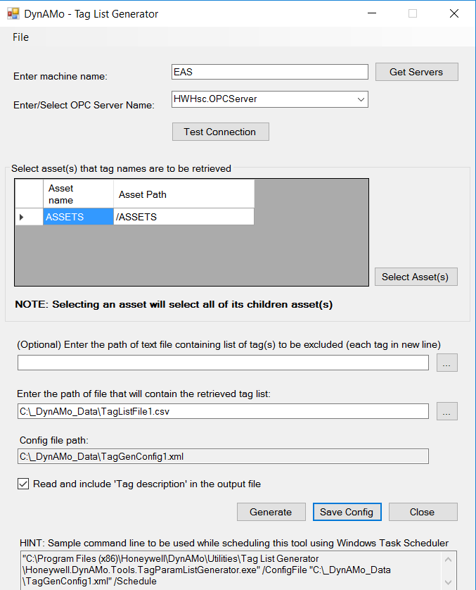
Project Checklist – Suppressed Sync
Step: (TagListGen asset selection) for suppressed sync. Ensure correct” assets are selected per channel as reporting is channel-based
- As sync\reports are channel based… they will not be correct otherwise. You can NOT just select all “Assets” (top level) as shown below.
Try Barbara’s SQL query…
___M&R Configure TagListGen help AND Check SyncQueue does not generate WRONG NEW tag or asset
Should we sync system tags\assets?
(Barbara) NO
Should we exclude some tags?
Probably YES (Barbara never did this,
nobody will maintain that)

Slide 24
Quiz
So I have asset Assets\AK with some points built on server SRV1 and some on SRV2. In which channel I should use AK for Suppressed Sync TagList?
SRV1
SRV2
Both SRV1 and SRV2
Try to use for the “largest” set…
This is one of the “Barbara’s reported issues”
Barbara: Suppress should be channel-independent!

Slide 25
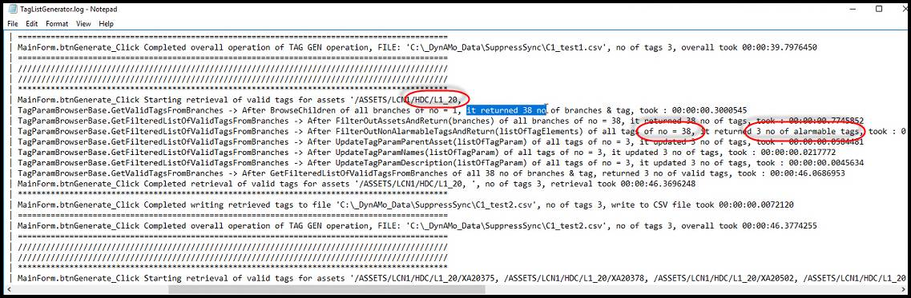
Project Checklist – Suppressed Sync
Step: (TagListGen did we capture all alarmable tags?)
How many tags you see? Is the list looking complete?
If running under mngr does not help (never helped me)….
Run ACM Tag Gen re-adding all tags
Detail the point and check… does it show?
If the site has ACM you may try to use “Barbara’s script” to generate the list from ACM… (this also avoids overloading OPC).
Barbara does not understand this concept of “waking up” the tags.

Slide 26
Active sync:
Get ready for collector

Slide 27
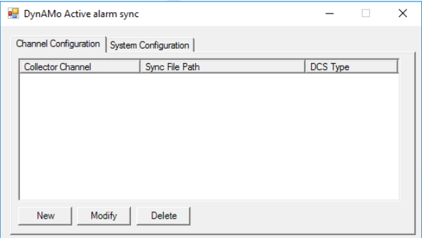
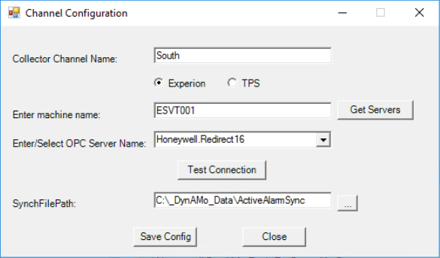
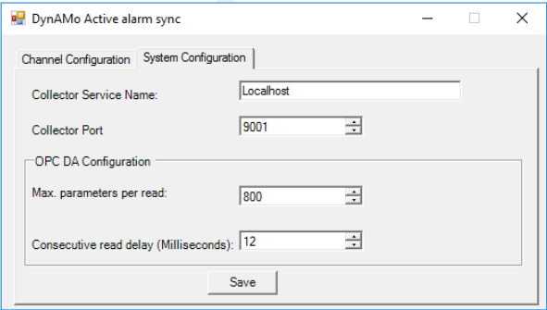
Active Alarms Sync (TPS or ESVT only)
Configure Active Sync utility Honeywell.DynAMo.MnR.OpenAlarmSyncUI.exe in
C:\Program Files (x86)\Honeywell\DynAMo\Utilities\Tag List Generator
Also create Map Files for each channel and put in OpenAlarmsSyncConfigFiles folder (updated samples may be requested from TAC)

Slide 28
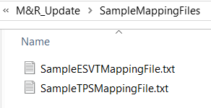
Active Alarms Sync (TPS or ESVT only)
Put Map files for each channel in OpenAlarmsSyncConfigFile folder (one file for channel with same name as the channel e.g. North.txt). Sample map files can be found in the latest patch\hotfix (likely there is no need to edit them).
Also create Map Files for each channel and put in OpenAlarmsSyncConfigFiles folder
#Tag,Condition,PriorityParameter,Flagparameter
ESVT:
,OFFNORM,OFFNRMPR,OFFNRMFL,PTINAL,HIGHAL/ENUM,HIGHALPR/ENUM
,UNREASBL,UNREASPR,UNREASFL,PTINAL,HIGHAL/ENUM,HIGHALPR/ENUM
TPS:
,OFFNORM,OFFNRMFL,OFFNRMPR
,UNREASBL,UNREASFL,UNREASPR

Slide 29
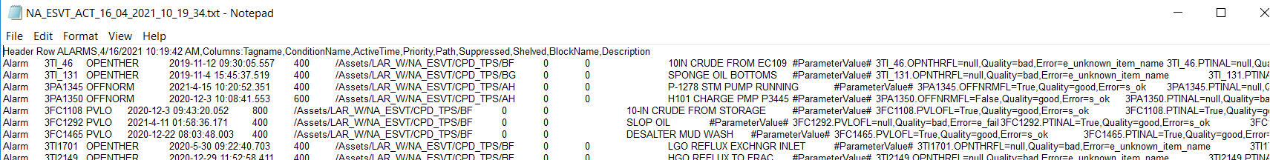
Project Checklist – Active Sync
Step: (ActiveSync utility map files) Look at file generated by Active Sync
OPC parameter reads on the right below should be there…
If not …Make sure map files are defined properly!

Slide 30
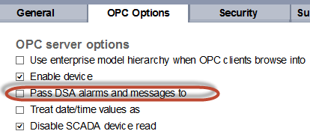
OPC settings confusions…
Generally “Pass DSA alarms and messages” is NOT selected so this is GOOD…
Active Sync Utility will get correct alarms
There is no need to select areas in Active Sync OPC channel
But if not…
Active Sync Utility will also get DSA alarms (so will not be correct)
You need to select Areas in Active Sync OPC channel (which is a problem if one asset contains tags from multiple servers)

Slide 31
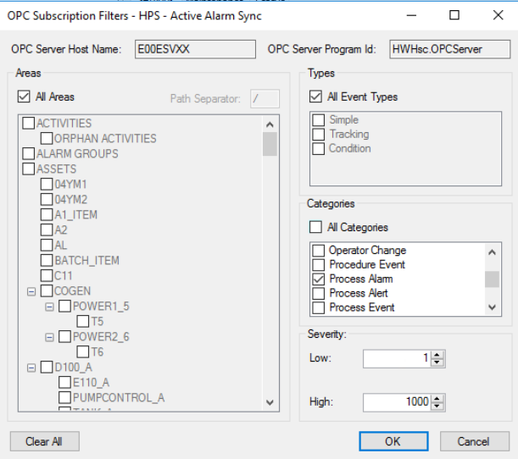
Project Checklist – Collector
Note: for Active Sync pure Experion use OPC channel and you can select the following categories…
Process Alarm <- select this one
Process Event <- no rules\metrics
System Alarm <- not very good rules

Slide 32
Windows Tasks

Slide 33
Windows schedules
The following needs to be scheduled in Windows Tasks
Tag List Generation e.g. monthly
"C:\Program Files (x86)\Honeywell\DynAMo\Utilities\Tag List Generator\Honeywell.DynAMo.Tools.TagParamListGenerator.exe" /ConfigFile "C:\_DynAMo_Data\TagListGen\TagGenConfigHierarchyOFFinAPP.xml" /Schedule
Active Alarm Sync (for TPS\ESVT when Active Sync Utility used) e.g. every 6 hours
"C:\Program Files (x86)\Honeywell\DynAMo\Utilities\Tag List Generator\Honeywell.DynAMo.MnR.OpenAlarmSync.exe" MyChannel

Slide 34
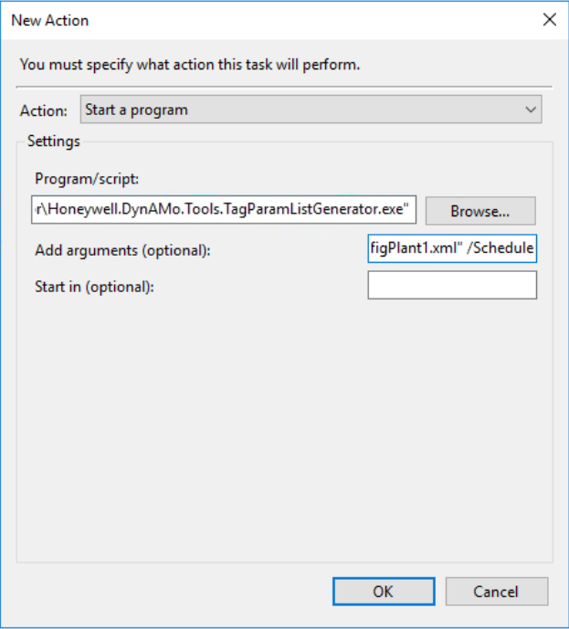
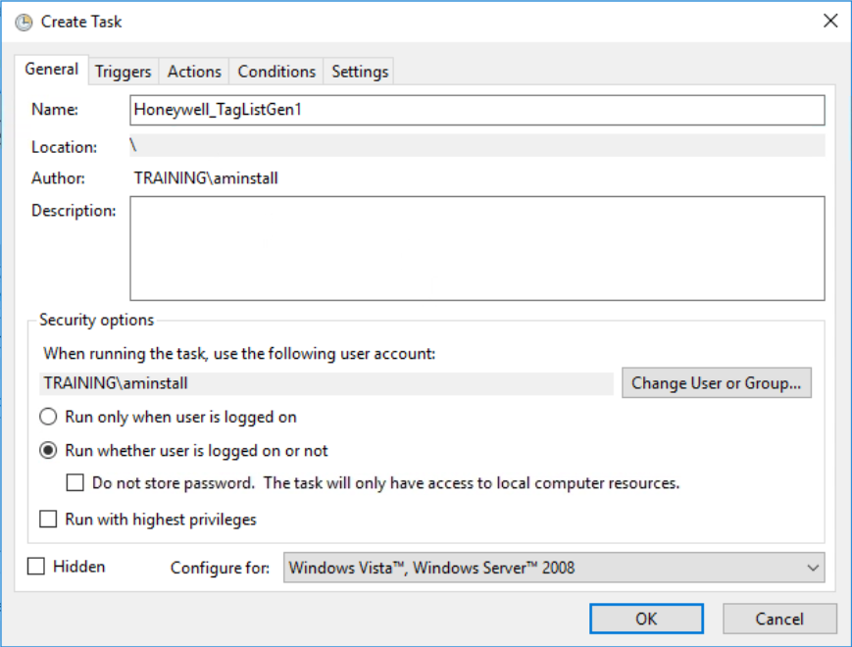
Windows Tasks
Both Active Alarm Sync (TPS\ESVT) and Tag List Generator need to be scheduled. Ensure windows tasks are set to Run whether user is logged on or not

Slide 35
Collector/Archiver

Slide 36
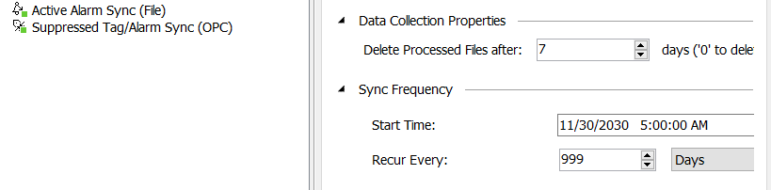
Project Checklist – Collector
Step Windows Tasks \ Collector:
“Synchronize Now”
(can Run Windows task for Active Sync)
Active Sync(file) Do not click twice…
second empty run will overwrite first run
For Active Sync using Utility… put 999 days
BAD idea schedule: Active Sync windows Task:5:00
Channel in collector:5:01

Slide 37
Project Checklist - Archiver
Restart Archiver Interface… you have 10 min now before DynAMoSyncQueue will be processed
Step 5 (DynAMoSyncQueue): Before you process DynAMoSyncQueue
  Suppression sync or\and Active sync can damage
Priority (Alternative sync can damage priority)
path
  Select distinct path from DynAMoSyncQueue
  where path not in (select path from DynAssets)
  Select distinct priority from DynAMoSyncQueue
You do not like something just …
Delete from DynAMoSyncQueue

Slide 38
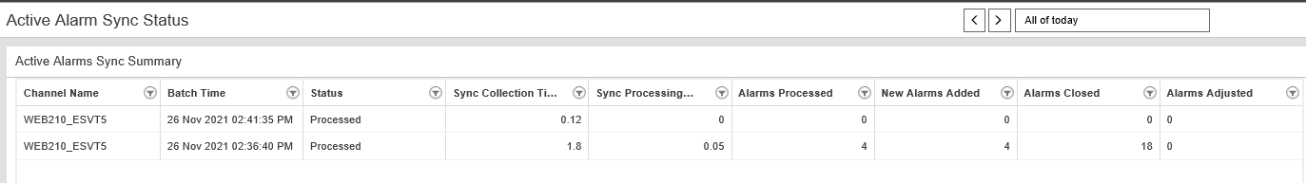
Project Checklist – is Sync reasonable?
  Step: (Reporting): Check if Active\Suppression Sync status is reasonable
  Is this “reasonable”? No
  … you should see more ReturnToNormal than Alarms

Slide 39
Web\Reports test

Slide 40
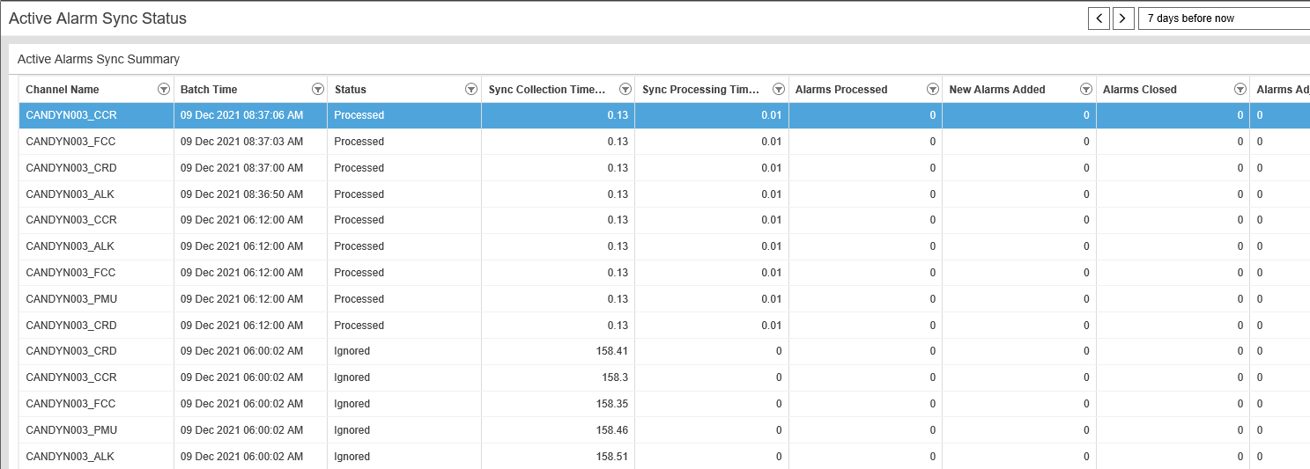
Project Checklist – is Sync reasonable?
  Is this reasonable? No

Slide 41
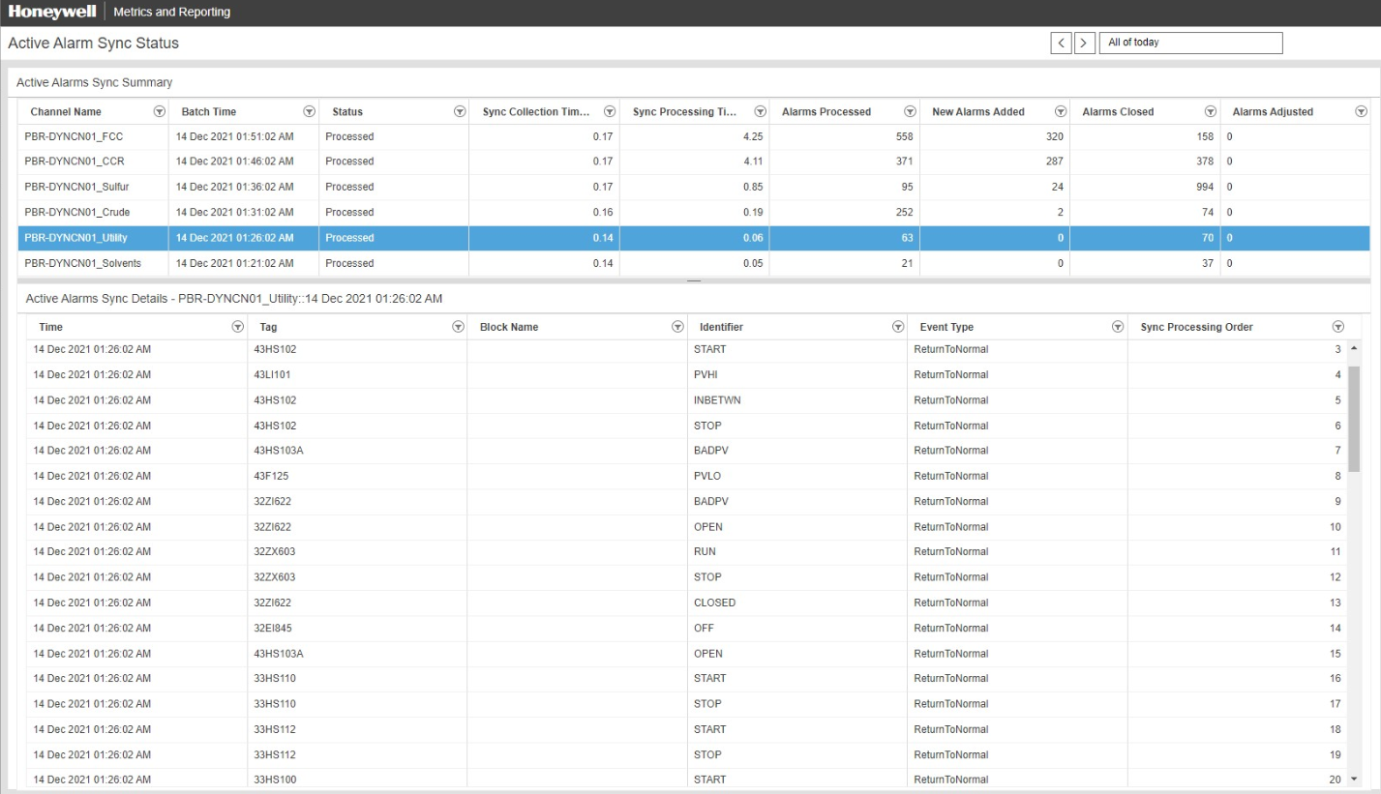
Project Checklist – is Sync reasonable?
  Is this reasonable? Yes for Utility
  (for Utility many CHOFST alarms closed)

Slide 42
Before final test… understand this…
“Confusion period”
Confusion 1:
~1-3 min for Active Sync
~ 10 min for Suppression Sync
What is “Confusion period”?
e.g. Suppression Sync takes 10 min to read all params
At 5 min mark…It reads 7HY264.alenbst as DISABLE
At 8 min mark…7HY264 is set to ENABLE by operator
Quiz: How Sync would sync… ENABLE or DISABLE?
Confusion 2:
Another confusion – events are not collected yet but… we are syncing

Slide 43
Final Test
Assign properly to Operating positions.
Check “Unassigned” assets
Look at DynAssets… (do the paths look right?)
Do not expect perfect for Active Alarms (due to time delay etc) but stale Alarms should be perfect
(we still have unfortunately limitation with standard functionality and few stale alarms may be still an issue….)!

Slide 44
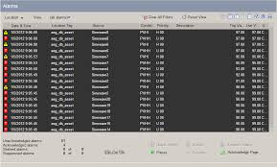
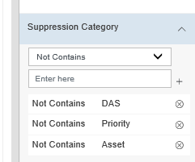
Project Checklist – FINAL CHECK?
  Final CHECK…
    1. Active Alarms report
    2. Suppressed Report
    Skip checking or… do not get frustrated about “Priority”, “DAS”, “Asset” suppression, or System alarms quality
    Check at least few (“”, “journalonly”) with the longest duration
    - can detail the point to validate or…
    - Use ACM Enforcements results or…
    - Reports in Experion
    3. Shelved Report
    Likely it will not be accurate for non-Active alarms….
    Make sure all execute properly on schedule

Slide 45
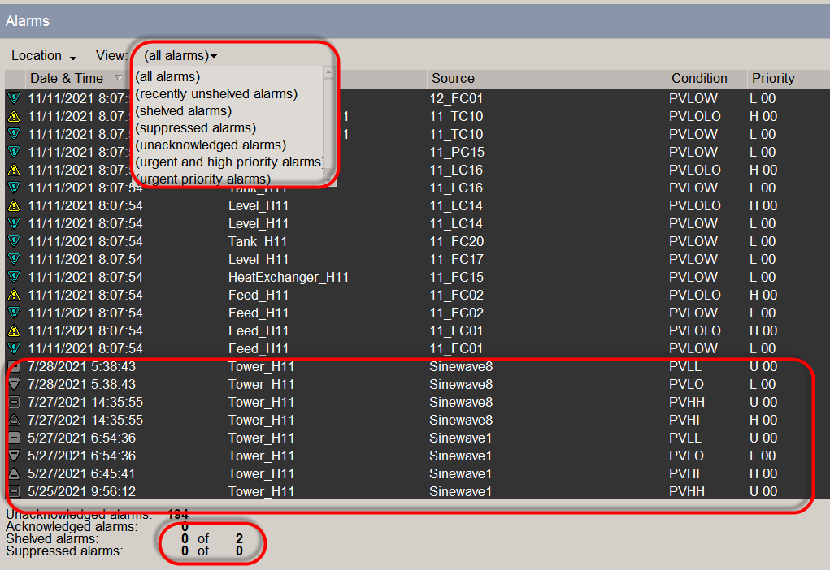
Active\suppressed\shelved
  Run on Operator station or… on server for OPC Standard Active Sync.

Slide 46
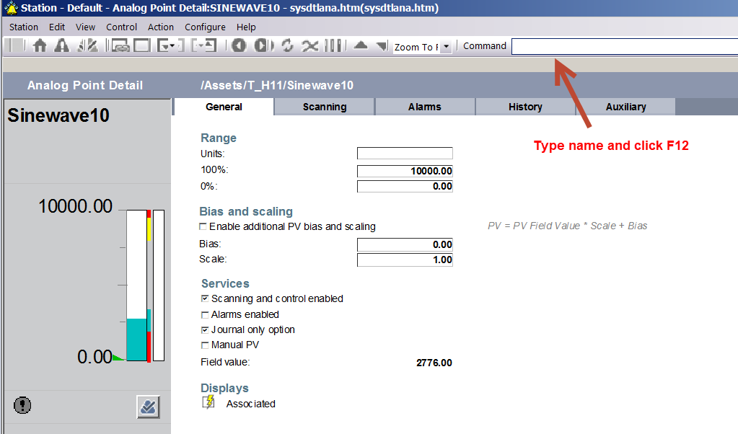
Suppressed
  Detail the point (can be done on EAS)

Slide 47
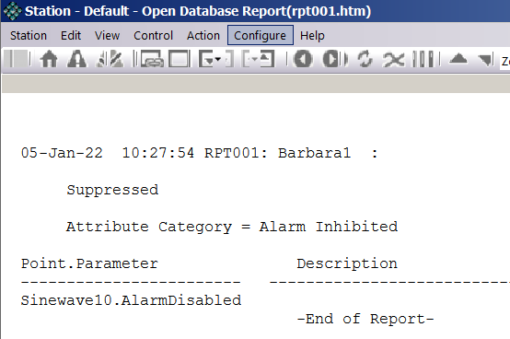
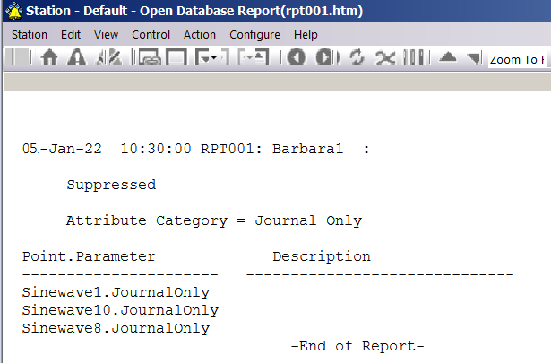
Suppressed
  Run Reports on operator station or server

Slide 48
Troubleshooting+
“Magic query”
By
Barbara Schubert

Slide 49

“Magic Query” vs Event Investigator
Guaranteed to return all events (even with incorrect path)
Shows the columns:
  “eventid”
  “system_all” - original message
  “vt_end”
Easy sort (by eventid!)
Easy filtering and sorting
Easy column ordering\selection
More records returned
Easy to see columns coming from “DynTagData”
Easy scrolling\view
No timeouts
No locking tables

Slide 50
Active Sync DataFlow
In “very rare” scenarios any “move” below may fail
DynSyncQueue
DynSyncBatchInfo rmation
DynOpenAlarmsSyncBatchDetails
DynOpenAlarmsSyncBatchStatistics
Active Alarm Sync Status Report
DynTagData
Event Investigator Report
DynEvent
Cache Files
Active Alarms Report

Slide 51
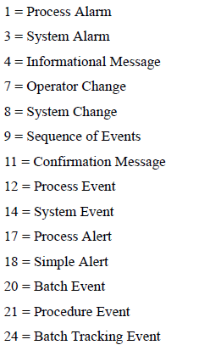
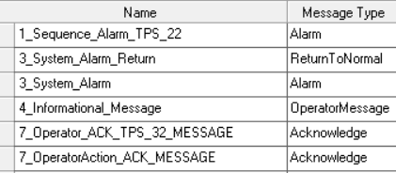
Rules Builder
ESVT provides the following categories
First digit in rule name will denote category

Slide 52
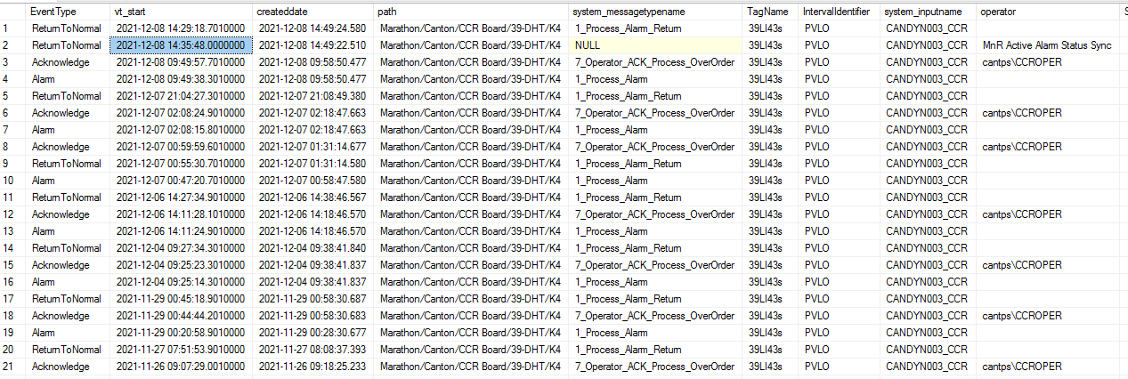
Example “Magic query” output
  Maybe execute a Magic Query for some items in the list, ensure it is reasonable+
  And verify Active Sync report matches the change.

Slide 53
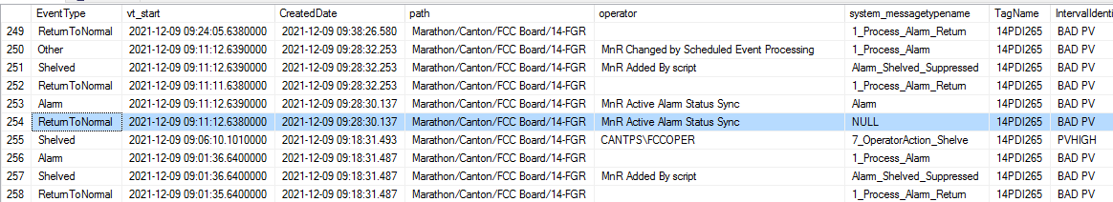

Slide 54
Example “Magic query” output

Slide 55
Why Alternative Sync?
It is very simple functionality (one script) developed at the beginning of 2021. All short instructions are inside this one script.
The extremely detailed internal manual was also created in 2022 only to address still strong un-comfortability with new functionality to hopefully speed up the general deployment.
By
Barbara Schubert

Slide 56



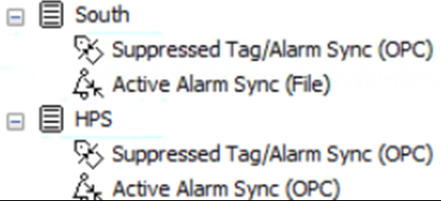







M&R OPC\File Active Alarms Sync
DCS
Rules Builder
4. Synchronization + KPI statistics (every 10 min)
Database
1.Gets the list of Open Alarms from DCS (ESVT) or M&R (TPS)
Messages
2. For ESVT\TPS alarms parameters are read to validate them later.
3. Archiver pulls data and processes using configured rules
Archiver
Collector

Slide 57
M&R NEW Active Alarms Sync
DCS
Rules Builder
4. Synchronization + KPI statistics (every 10 min)
Database
1.Notifdump files from every station
Messages
2. “Process” the files (NEW SCRIPT) to create one ACT file to give to collector
3. Archiver pulls data and processes using configured rules
Archiver
Collector

Slide 58
Why new Sync? Can I use standard sync?
Experion standard OPC Active Sync Issues
  Generally we think there are no issues but…
  OPC load and connectivity issues
  Timing… sync is processed before all relevant events are collected
  Advanced security on Experion may make deployment unreasonably complicated\impossible
  Dependency on OPC hierarchy settings (what if one day they will change it?)
  No full shelve\DSA sync

Slide 59

Why new Sync? Can I use standard sync?
ESVT standard Active Sync Issues
  Deals only with “ghost” alarm but not with “missing” alarms
    DE was not aware of this issue! So we were constantly fixing “unfixable”
  OPC load and connectivity issues
  Timing… sync is processed before all relevant events are collected
  Extremely complicated logic
    Realistically impossible to troubleshoot (or understand)…
    It is not WYSIWYG
TPS alarms are only correct on ESTs=station.
TPS alarm may be “ghost” or “missing” on ESVT=server
Cannot ask customer to keep ESTs and ESVTs in sync – it is intrusive and will not eliminate “out-of-sync” periods
Experion alarms will be correct on server and station.

Slide 60
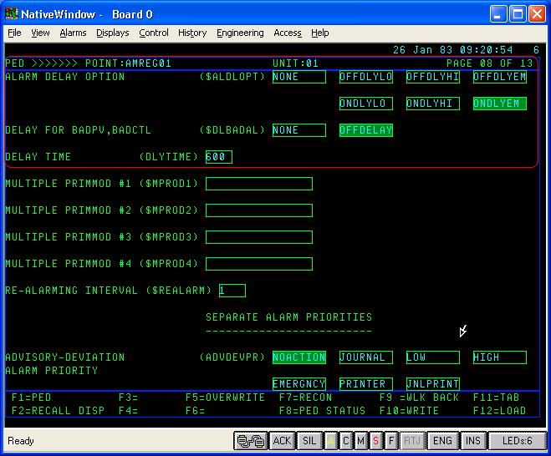
Why new Sync? Can I use standard sync?
Hybrid system
  There is no standard sync for Hybrid system
  Until Barbara’s visit to LAR we were not aware of such setup
  New sync is the only option to get accuracy
Hybrid means that although Experion server is present still some areas are controlled by Operators in front of Native Window.
ASK the customer if operator is looking at Station or Native Window, where they ACK alarms?

Slide 61
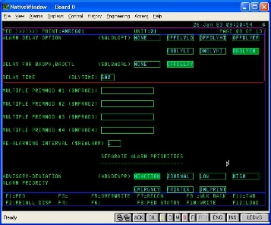
Why new Sync? Can I use standard sync?
TPS standard Active Sync Issues
  There is no OPC refresh to get active alarms for syncing. Can only validate alarms opened in M&R.
  This really ONLY works against EJC collection (we only fixed alarmidentifier for EJC)… still there are limitations
  OPC load and connectivity issues
  Timing… sync is processed before all relevant events are collected (I think there is undocumented way to address this)
  Extremely complicated logic
    Realistically impossible to troubleshoot…
    Many (Barbara included) still do not fully understand this functionality

Slide 62

Why new Sync better?
ACCURATE and less confusing that Standard sync which…
Syncs after collection is fully done (thus not generating many “…-redundant” events)
Alarms with “Unknown” timestamp – “…-wrong” ReturnToNormal not generated(only HF6 gets factual timestamp)
Can validate the file (it is WYSIWYG, and not overcomplicated OPC logic)
We do not care about OPC options\struggles (e.g. hierarchy settings, OPC failures)
We do not care about Advanced security
ESVT can have ghost alarms, Sync validates them but… cannot validate some (“known limitations”)… No issue here
ESVT can have missing alarms – DE was not even aware!... No issue here
-------
We do not have standard sync for Hybrid system
TPS – only can validate alarms (cannot add\detect missing alarms) and only EJC works (as AlarmIdentifiers were only fixed for EJC! And sync was designed against this EJC collection way… it will not work well with any other TPS collection methods)

Slide 63

Why Alternative Sync?
Quality!
Clarity! (vbs script so no logic hidden in executables)
Supportability!
Simple Validation Logic WYSIWYG
vs.
Standard sync file (shown below) with ghost alarms, missing alarms and logic to the right impossible to understand

Slide 64
Active Sync History…
HYBRID – (Carson and Wilmington) Implemented first time with LAR in April
ESVT – Robinson and Canton
    Garyville… in progress
TPS – Paulsboro (December)… looks great but had significant issues with DynAMo (including cache corruption) so… just waiting to declare full success (or adjust if any issues identified… potentially may be related to invalid identifiers)
Quality of Active Alarms report will be consistently close to 100%. It will not deteriorate over time

Slide 65
How complicated is new Sync?
Extremely Complicated
Standard sync requires the customer to keep ESVTs in sync (very intrusive)
Standard Active Sync logic
custom DCSes scripts\implementation
(New Sync) TPS queries construction (should be easy for the customers and definitely easy for Roy!!)
(New Sync) Hybrid (TPS+EST)
(New Sync) Pure TPS (small limitations, still way better than standard sync!)
(New Sync) ESVT
(New Sync) Pure Experion
Extremely Easy

Slide 66
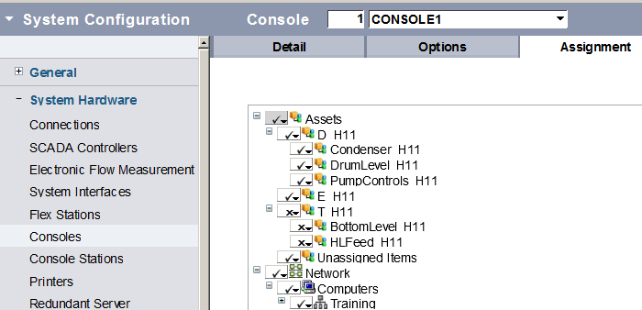
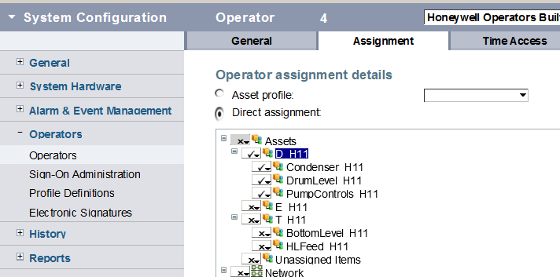
Will notifdmp return only alarms operator see?
No, it will return all alarms assigned to the console, users (e.g. operators) can be configured to see subset of these assets.

Slide 67

Quick Implementation:
Generate files on EST\ESVT\ESV (or TPS) and put in one location (can be network)
- get all alarms (TPS alarms from TPS or EST, not from ESVT!)
Edit and Run ActiveSync_GenerateFilesForDynAMo to process files to generate ACT file (add one section per each channel)
g_ChannelName="ESVT4"
g_ServerNames=Array("localhost","ESVT4")
g_AlmDmpPrefixes=Array("L4EST47","L4ACTSY","L4SEQSY")
call ProcessOneChannel()
Validate ACT file ← WYSIWYG (check no DSA alarms)
Edit PPS (to adjust priority or path)
(priority sample script at the bottom of ActiveSync_GenerateFilesForDynAMo)
Schedule Active Sync to process the files

Slide 68
HowTo new Sync?
1. Schedule files generation 5:00am
Create notifdump files on
For Experion alarms
    Experion servers A\B
    or EAS (subscribe for alarms)
For TPS alarms
      files on each station or
      TPS query files
e.g.
      NotifConsESVa.txt
      NotifConsESVb.txt
…and copy to <X>:\_DynAMo_Data\ActiveSync\ActiveSyncFileGeneration\SourceFiles

Slide 69
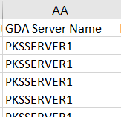

HowTo new Sync – prepare script
2. Edit new ActiveSync script:
Add this section to VBS script for every channel:
  g_ChannelName="ESVT4"
g_ServerNames=Array("localhost",“PKSSERVER1")
g_AlmDmpPrefixes=Array("L4EST47","L4ACTSY","L4SEQSY")
call ProcessOneChannel()
Notifdmp
Files

Slide 70
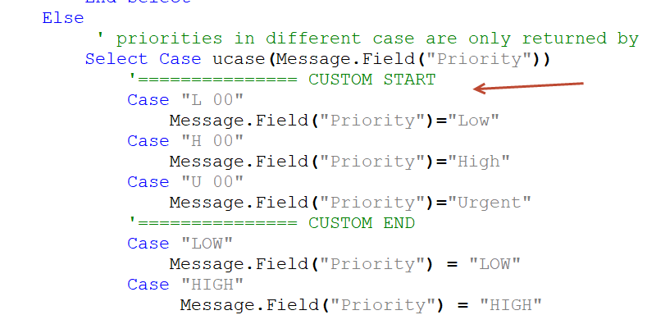
HowTo new Sync – prepare PPS script
3. Edit PPS script (for DynAMo utility):
Make sure correct mapping\logic for
Priorities (sample script at the bottom of ActiveSync_GenerateFilesForDynAMo)
  Experion notifdmp returns U 00 and not Urgent\400
  TPS e.g. returns LOW and not Low
Path (but likely you already have this logic implemented)
  TPS system has only unit
Notes:
I decided not to map in my script

Slide 71
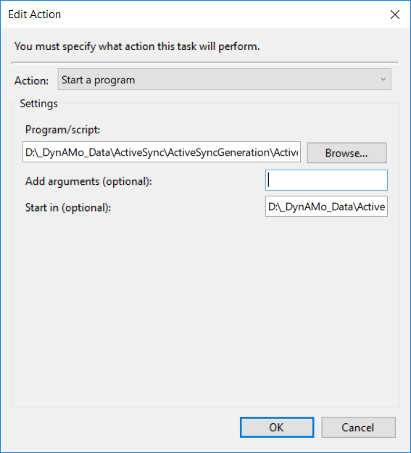
HowTo new Sync?
3. Schedule New Script 5:05am in Windows Task
Run script in (“Run in” below)
<X>:\_DynAMo_Data\ActiveSync\ActiveSyncGeneration

Slide 72
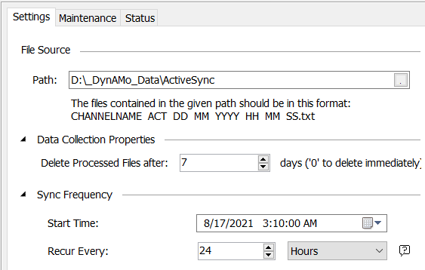
HowTo new Sync?
4. Schedule Active Sync 5:15am
Schedule Active Sync channel
Before you enable the channel give ACT file to the customer to review:
Do we have all alarms?
Are DSA alarms properly excluded?

Slide 73
HowTo new Sync (ESVT)?
5. (ESVT and TPS only)
Only 202 HF6 has 1979 fix. For all others you need to create trigger to replace this with correct timestamp. Already written by Barbara and successfully used at many sites.

Slide 74
TODOs…Confusions… What is left…
General
What DE will\should fix?
How far we should go with custom logic?
  - Should we sync shelving? Should we fix other DynAMo limitations?)
  We have to!
  - Should we prepare “System Report”
  - Priority… enhance for severity
TPS
Should we include sequence alarms? (<1% in LAR, none in Paulsboro).
NO
4. Adjust identifiers if needed (already adjusted for most important)
Suppressed Sync
Should we switch to file sync from OPC Sync? I know how to do this for TPS system, still did not figure out Experion (if I only can get few short answers…)

Slide 75
GOAL
Perfect sync!
Advanced Active Sync will eliminate the need for manual “close alarm”.
Unfortunately manual unshelve and unsuppress is still required (and some suppression activities are wrong)….
Perfect collection is very long goal and we should not concentrate on this (it requires Experion fixes)

Slide 76
www.honeywell.com

Slide 77
Quiz
I came to site to upgrade the system that Barbara installed. That will be configured perfectly so no need to check anything?
OMG, Definitely you need to check.
“It's only those who do nothing that make no mistakes”
System may deteriorate… may not work any more

